Slide 1

Noida Institute of Engineering and Technology, Greater Noida
Business Organizations and E- Governance
Unit: 5
Constitution of India, Law & Engineering
Ms. Manju
Assistant Professor, Department of MBA
Course Details (B. Tech 5th Semester)

Slide 2

Faculty Biodata
Faculty Name: Ms. Manju
Designation: Assistant Professor (Department of Management
Studies)
Area of Interest: HR, Marketing, Knowledge Management
Educational Qualification:
Ph.D. Submitted, M.B.A (HR), Ugc Net Qualified (Management).

Slide 3

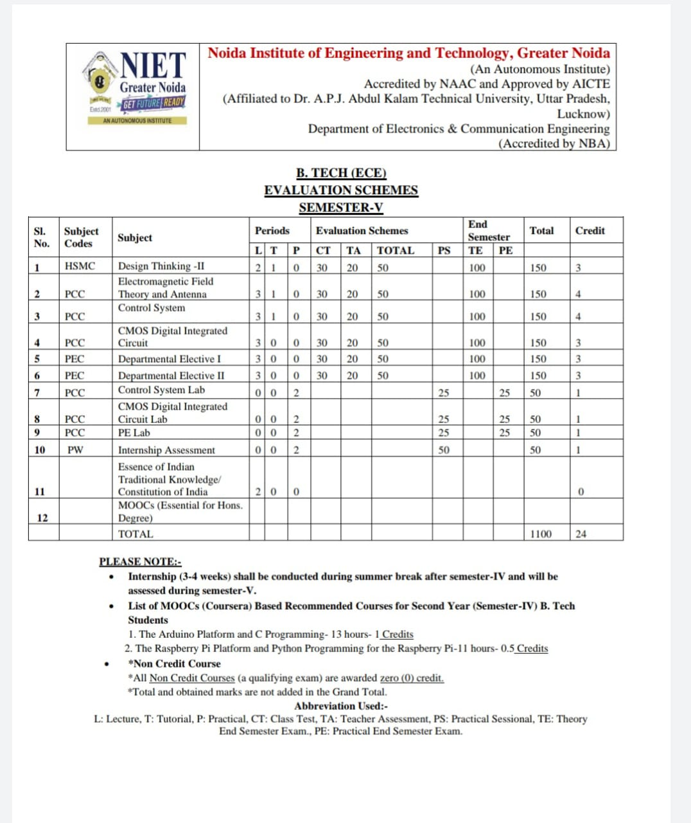
Evaluation Scheme

Slide 4

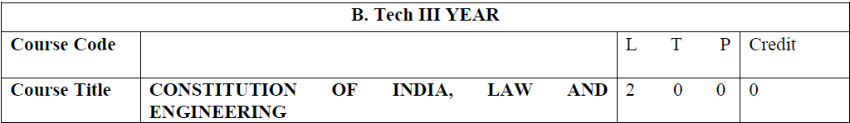
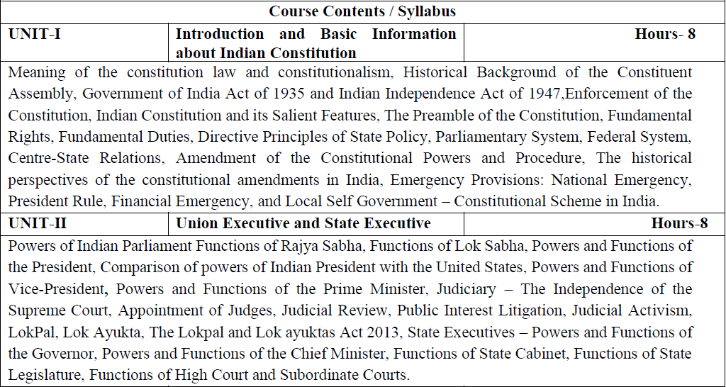
Syllabus

Slide 5

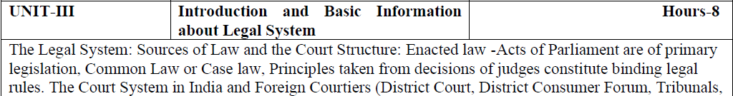
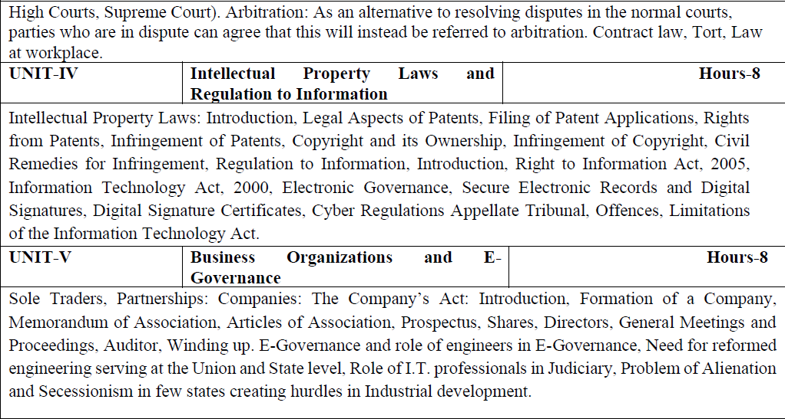
Syllabus

Slide 6

Branch wise Applications
Legal knowledge
Individual rights
Duties of a citizen
Patient filling
Business setup

Slide 7
Course Objectives
Course Objectives:
The student will try to learn about:
To acquaint the students with legacies of constitutional development in India and help those to understand the most diversified legal document of India and philosophy behind it.
To make students aware of the theoretical and functional aspects of the Indian Parliamentary System.
To channelize students’ thinking towards basic understanding of the legal concepts and its implications for engineers.
To acquaint students with latest intellectual property rights and innovation environment with related regulatory framework.
To make students learn about role of engineering in business organizations and e-governance.

Slide 8
Course Outcome (CO)
Course Outcome:
After successful completion of the course students will demonstrate the ability to
CO1: Identify and explore the basic features and modalities about Indian constitution.
CO2: Differentiate and relate the functioning of Indian parliamentary system at the center and state level.
CO3: Differentiate different aspects of Indian Legal System and its related bodies.
CO4: Discover and apply different laws and regulations related to engineering practices.
CO5: Correlate role of engineers with different organizations and governance models

Slide 9

Program Outcomes
Program Outcomes are narrow statements that describe what the students are expected to know and would be able to do upon the graduation.
These relate to the skills, knowledge, and behavior that students acquire through the programmed.
Engineering knowledge
Problem analysis
Design/development of solutions
Conduct investigations of complex problems
Modern tool usage
The engineer and society
Environment and sustainability
Ethics
Individual and team work
Communication
Project management and finance
Life-long learning

Slide 10
CO-PO Mapping
COs | POs | PO1 | PO2 | PO3 | PO4 | PO5 | PO6 | PO7 | PO8 | PO9 | PO10 | PO11 | PO12
CO1 |  | - | - | - | - | - | - | - | 3 | - | - | - | 3
CO2 |  | - | - | - | - | - | - | - | 3 | - | - | - | 3
CO3 |  | - | - | - | - | - | - | - | 3 | - | - | - | 3
CO4 |  | - | - | - | - | - | - | - | 3 | - | - | - | 3
CO5 |  | - | - | - | - | - | - | - | 3 | - | - | - | 3
Average |  | - | - | - | - | - | - | - | 3 | - | - | - | 3
Note: Correlation levels are taken 1, 2 and 3 as defined below:
1: Slight (Low) 2: Moderate (Medium) 3: Substantial (High)
If there is no correlation, put ‘-’

Slide 11
Program Specific Outcomes
Program Specific Outcomes (PSOs) are what the students should be able to do at the time of graduation. The PSOs are program specific. PSOs are written by the department offering the program.
PSO1: To apply the knowledge of mathematics, science and electronics & communication engineering to work effectively in the industry based on same or related area.
PSO2: To use their skills to work in modern electronics & communication engineering tools, software and equipments to design solutions for complex problems in the related field that meet the specified needs of the society.
PSO3: To function effectively as an individual and as a member or leader of a team by qualifying through examinations like GATE (Graduate Aptitude Test in Engineering), IES (Indian Engineering Services), PSUs (Public Sector Undertakings), TOEFL (Test of English as a Foreign Language), GMAT (Graduate Management Admission Test) and GRE (Graduate Record Examinations in US) etc.

Slide 12
CO-PSO Mapping
COs | PSOs | PSO1 | PSO2 | PSO3
CO1 |  | - | - | -
CO2 |  | - | - | -
CO3 |  | - | - | -
CO4 |  | - | - | -
CO5 |  | - | - | -
Average |  | - | - | -
Note: Correlation levels are taken 1, 2 and 3 as defined below:
1: Slight (Low) 2: Moderate (Medium) 3: Substantial (High)
If there is no correlation, put ‘-’

Slide 13
Program Educational Objectives
The Program Educational Objectives (PEOs) of an engineering degree program are the statements that describe the expected achievements of graduates in their career, and what the graduates are expected to perform and achieve during the first few years after graduation.
PEO1: To have an excellent scientific and engineering breadth so as to comprehend, analyze, design and solve real-life problems using state-of-the-art technology.
PEO2: To lead a successful career in industries or to pursue higher studies or to understand entrepreneurial endeavours.
PEO3: To effectively bridge the gap between industry and academics through effective communication skill, professional attitude and a desire to learn.

Slide 14
Result Analysis
Department wise:
OVERALL CLEAR PASS STUDENTS | 65
OVERALL PASS % | 48.51%
SUBJECT | KME501 | KME502 | KME503 | KME051 | KME055 | KAU051 | KAU052 | KME052 | KME056 | KME551 | KME552 | KME553 | KME554 | KNC501
NO.OF BACKLOGS | 30 | 47 | 7 | 1 | 3 | 8 | 16 | 0 | 10 | 0 | 0 | 0 | 0 | 0
BACKLOG % | 22.39% | 35.07% | 5.22% | 0.75% | 2.24% | 5.97% | 11.94% | 0.00% | 7.46% | 0.00% | 0.00% | 0.00% | 0.00% | 0.00%
PASS % | 77.61% | 64.93% | 94.78% | 99.25% | 97.76% | 94.03% | 88.06% | 100.00% | 92.54% | 100.00% | 100.00% | 100.00% | 100.00% | 100.00%

Slide 15
Result Analysis
Faculty wise:
Ms. Manju | Subject 1 (KME052) [section C] | SUBJECT 2(KNC 501) [section A] | SUBJECT 2(KNC 501 [section B] | SUBJECT 2(KNC 501) [section C] | SUBJECT 2( KNC 501) [section D]
BACKLOG | 0 | 0 | 0 | 0 | 0
PASS % | 100% | 100% | 100% | 100% | 100%
Subject wise:
Subject Code | Subject Name | Total Student | Backlog Number | Pass %
KNC 502 | COILE | 135 | 0 | 100%

Slide 16
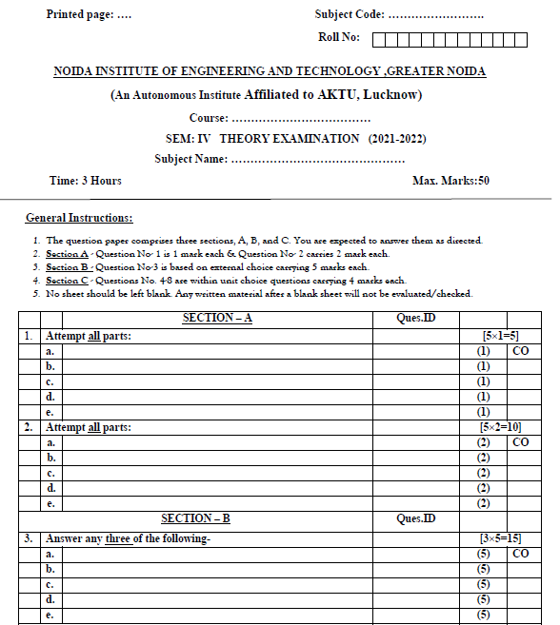
End Sem Question Paper Template

Slide 17
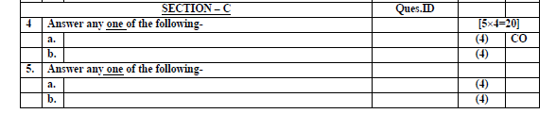
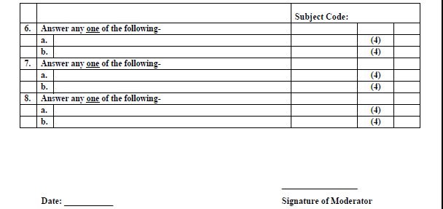
End Sem Question Paper Template

Slide 18
Prerequisite and Recap
Basic knowledge of political science.
Basic idea about society

Slide 19
Brief Subject Introduction with Video
To acquaint the students with legacies of constitutional development in India and help those to understand the most diversified legal document of India and philosophy behind it. To make students aware of the theoretical and functional aspects of the Indian Parliamentary System. To channelize students’ thinking towards basic understanding of the legal concepts and its implications for engineers. To acquaint students with latest intellectual property rights and innovation environment with related regulatory framework. To make students learn about role of engineering in business organizations and e-governance.
https://www.youtube.com/watch?v=eS03-itWEPs

Slide 20
Content (Unit 5)
Sole Traders, Partnerships: Companies: The Company’s Act: Introduction, Formation of a Company, Memorandum of Association, Articles of Association, Prospectus, Shares, Directors, General Meetings and Proceedings, Auditor, Winding up.
E-Governance and role of engineers in E-Governance, Need for reformed engineering serving at the Union and State level, Role of I.T. professionals in Judiciary, Problem of Alienation and Secessionism in few states creating hurdles in Industrial development.

Slide 21
Unit Objective
To make students aware of the role of engineering in business organizations and e-governance.

Slide 22
Topic Objective/ Topic outcome
Name of Topic | Objective of Topic | Mapping with CO
Companies: The Company’s Act: Introduction, Formation of a Company, Memorandum of Association, Articles of Association. | Students will be able to learn about basics of company formation. | CO5

Slide 23
Companies Act, 2013
The Companies Act 2013
Companies Act regulates the formation and functioning of corporations or companies in India. The first Companies Act after independence was passed in 1956, which governed business entities in the country. The 1956 Act was based on the recommendations of the Bhabha Committee. This Act was amended multiple times, and in 2013, major changes were introduced. By Section 135 of the 2013 Act, India became the first country to make corporate social responsibility (CSR) spending mandatory by law.

Slide 24
Companies Act,2013
Companies Act, 2013
The Companies Act was an Act of the Parliament of India, which enabled companies to be formed by registration, and set out the responsibilities of companies, their directors and secretaries.
A company is a “legal” person. A company thus has legal rights and obligations in the same way that a natural person does. Companies Act deals with everything from an incorporation of a company to it’s winding up.

Slide 25
NATURE OF COMPANY
1 SEPERATE LEGAL ENTITY
2.ARTIFICIAL PERSON
3.PERPETUAL EXISTENCE
4.COMMON SEAL
5.LIMITED LIABILITY
6.CAPACITY TO SUE OR TO BE SUED
7.TRANSFERABILITY OF SHARE

Slide 26
NATURE OF COMPANY (Continue..)
Separate legal entity
A company is an separate legal entity means it is different from its members. It works as a individual body.
It can make contracts, open a bank account, can sue and be sued by others.
Artificial person
A company is a purely a creation of law. It is invisible, intangible and exists only in the eyes of law.
It has no soul, no body, but has a position to enter or exit into a contract, to appoint a people as its employees
In short it can do every thing just like a natural person

Slide 27
Perpetual existence [sec 34(2)]
NATURE OF COMPANY (Continue..)
Section 34(2) of the act states that an incorporated company has perpetual life.
The life of the company is not related to the life of the members . Law create the company and law alone can dissolve it.
The existence of the company is not affected b y death, insolvency, retirement or transfer of share of members.
It means that the liability of a member shall be limited to the value of the share held by him, he cannot be called upon to bear the loss from his personal property.
Limited liability

Slide 28
NATURE OF COMPANY (Continue..)
Transferability of share sec(82)
The share of a company are freely transferable. The shareholder can transfer his share to any person without the consent of other members.
A company cannot impose absolute restrictions on the rights of member to transfer their shares

Slide 29
Capacity to sue and be sued
NATURE OF COMPANY (Continue..)
When a company incorporated it acquire a separate and independent legal personality. As a legal person it can be sue and be sued in its own name.

Slide 30
Formation of Company
Step 1:- Application for allotment of Director Identification Number in DIR-3
Attachments- ID Proof, Residence Proof, Copy of Verification by Applicant in DIR-4, Specimen Signature.
Step 2: – Application of Name availability / Reservation of Name INC-1
Step 3: – Application for Incorporation of Company INC-7
Attachments-
Memorandum of Association,
Article of Association,
Declaration INC-8,
Affidavit from Each Subscriber in INC-9
Specimen Signature in INC- 10

Slide 31
Formation of Company (Continue..)
Step 4: – Notice of Situation of registered Office of Company under Incorporation INC-22
Attachments-
Proof of Registered Office address (Conveyance/Lease deed/Rent Agreement along with the rent receipts) etc.;
A proof that the Company is permitted to use the address as the registered office of the Company if the same is owned by any other entity/ Person (not taken on lease by company)
Step 5:- Intimation regarding its First Directors DIR-12
Attachments-
Consent to act as a Director in DIR-2
Interest in Other entities

Slide 32
Formation of Company (Continue..)
Step 6:- Declaration prior to commencement of business INC-21
(Declaration has to be filled by Director within a period of 180 days from the date of incorporation )
Attachments-
Certificate of Incorporation
Specimen Signature in INC- 10

Slide 33
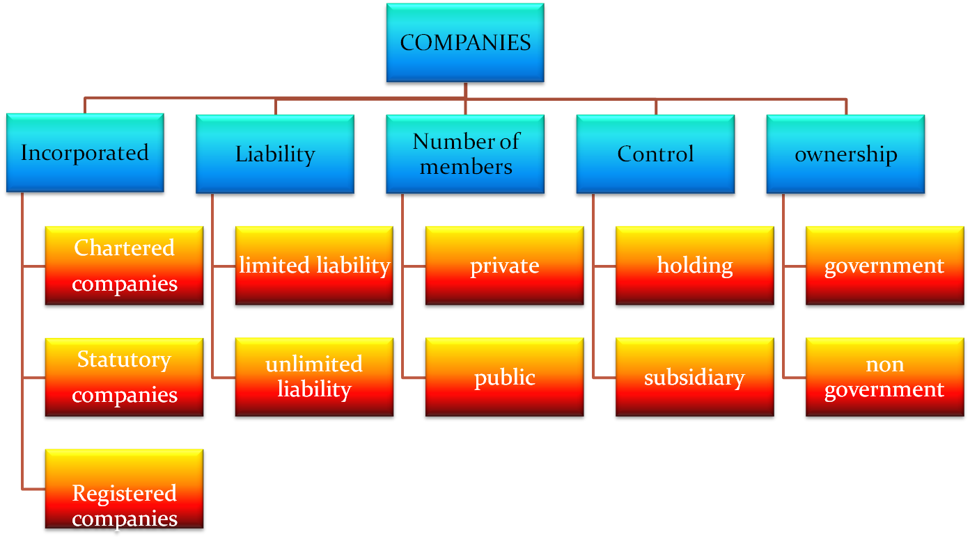
Types of companies

Slide 34
Definition : Private & Public Company
A private company is one which, by its Article of association restricts the right to transfer its share, limits the maximum number of its member to fifty, prohibits any invitation to the public to subscribe for any share or debenture of the company.
A public company means a company which is not a private company. In other words, a public company, means a company which by its article does not limit the number of its member & does not prohibit any invitation to the public to subscribe for any share or debentures, of the company.

Slide 35
Private Vs Public Company
 | Private Company | Public Company
Minimum paid up capital | 1 Lac | 5 Lacs
Minimum no of members | 2 | 7
Maximum no of members | 50 | No limit
Minimum no of Directors | 2 | 3
Transfer of Shares | Restricted AOA & requires the prior permission of Board of Directors | Shareholders can transfer shares freely

Slide 36
Private Vs Public Company(Continue..)
 | Private Company | Public Company
Public Subscription | AOA prohibits any invitation to public to subscribe to its sharess & debentures | Can invite public to subscribe to its shares & debentures
Acceptance of public Deposits | AOA prohibits acceptance of deposits from public | Can acceptance of deposits from public
Commencement of Business | Immediately after Certificate of Incorporation | Only after getting the Certificate of commencement of Business
Issue of prospectus | Need not prepare or file 'Prospectus' or 'statement in lieu of prospectus' with registrar | Must prepare or file Prospectus with registrar

Slide 37
Private Vs Public Company(Continue..)
 | Private Company | Public Company
Statutory meeting | Not required to hold | Must hold after one month and before 6 months from date of obtaining the Certificate of commencement of business
Provisions regarding directors | No Central Govt approval for appointing and reappointing of MD or Whole time director | Central Govt approval is must for appointing and reappointing of MD or Whole time director
Managerial remuneration | No restriction on payemnt of remuneration to directors & MD's | Remuneration is fixed at 11 % of net profits
Index of members | Need not maintain index of members | Must maintain index of members if no of members exceed 50

Slide 38
MEMORANDUM OF ASSOCIATION
The first step in the formation of the company is to prepare memorandum of association. it is one of the documents which has to be filed with registrar of the companies at the time of incorporation of a company.
MOA of a company is its character and defines the limitation of the power of the company . MOA contains the fundamental condition upon which the company is allowed to incorporated.
The purpose of MOA is to enable the Shareholders, creditors and those who deal with the company to know what is permitted range of enterprise

Slide 39
MEMORANDUM OF ASSOCIATION(Continue..)
The first step in the formation of the company is to prepare memorandum of association. it is one of the documents which has to be filed with registrar of the companies at the time of incorporation of a company.
MOA of a company is its character and defines the limitation of the power of the company . MOA contains the fundamental condition upon which the company is allowed to incorporated.
The purpose of MOA is to enable the Shareholders, creditors and those who deal with the company to know what is permitted range of enterprise

Slide 40
IMPORTANCE OF MOA
It defines the rights and liabilities of the members.
It shows the capital structure of the company
It shows the object of the company
It specifies the state in which the registered office of the company is situated.
It shows the constitution of the company
It specify the conditions under which the company has been incorporated.

Slide 41
CLAUSES OF MEMORANDUM OF ASSOCIATION
The Companies Act, 2013 which are as follows:-
1. Name Clause
2. Registered office Clause
3. Object clause
4. Liability clause
5. Capital Clause
6. Subscriber Clause

Slide 42
ARTICLES OF ASSOCIATION (AOA)
The Companies Act, 2013 defines ‘articles’ as the “articles of association of a company originally framed, or as altered from time to time in pursuance of any previous company laws or of the present.” The Articles of Association of a company are that which prescribe the rules, regulations and the bye-laws for the internal management of the company, the conduct of its business, and is a document of paramount significance in the life of a company. The Articles of a company have often been compared to a rule book of the company’s working, that regulates the management and powers of the company and its officers. It prescribes several details of the company’s inner workings such as the manner of making calls, director’s/employees qualifications, powers and duties of auditors, forfeiture of shares etc.

Slide 43
CONTENTS OF AOA
Rights of different classes of shareholder.
Use of common seal of the company.
Different classes of shares and their right.
Appointment , powers, duties, salary of MD, manager, and secretary.
Borrowing power of directors.
Voting rights of member .
Board meetings and proceedings.
Winding up company.

Slide 44
Distinction Between Memorandum and Articles of Association
S.No. | Memorandum of Association | Articles of Association
1 | Contains fundamental conditions upon which the company is incorporated. | Contain the provisions for internal regulations of the company.
2 | Meant for the benefit and clarity of the public and the creditors, and the shareholders. | Regulate the relationship between the company and its members, as well amongst the members themselves.
3 | Lays down the area beyond which the company’s conduct cannot go. | Articles establish the regulations for working within that area.
4 | Memorandum lays down the parameters for the articles to function. | Articles prescribe details within those parameters.

Slide 45
Distinction Between Memorandum and Articles of Association
S.No. | Memorandum of Association | Articles of Association
5 | Can only be altered under specific circumstances and only as per the provisions of the Companies Act, 2013. Permission of the Central Government is also required in certain cases. | Articles can be altered a lot more easily, by passing a special resolution.
6 | Memorandum cannot include provisions contrary to the Companies Act. Memorandum is only subsidiary to the Companies Act. | Articles cannot include provisions contrary to the memorandum. Articles are subsidiary to both the Companies Act and the Memorandum.
7 | Acts done beyond the memorandum are ultra vires and cannot be ratified even by the shareholders. | Acts done beyond the Articles can be ratified by the shareholders as long as the act is not beyond the memorandum.

Slide 46

Daily Quiz
The Companies act 1956 was replaced by Companies Act___
A. 2013
B. 2000
C. 2005
D. None of the above
The company shall furnish to the Registrar verification of its registered office within a period of___ of its incorporation in such a manner as may be prescribed.
A. 60 days
B. 45 days
C. 15 days
D. 30 days
Memorandum of a company defines it:
A. Scope of operation
B. Borrowing powers
C. Capital
D. Nature of business

Slide 47
Daily Quiz
Property of the company belongs to
(a) Company (b) Share holders (c) Members (d) Promoters
Which company shares can be freely transferable
(a) Private Company (b) Public Company (c) Both (a) & (b) (d) None of the above
Minimum number of members in case of public company
(a) 1 (b) 2 (c) 5 (d) 7

Slide 48

Weekly assignment
Discuss formation of companies act, 2013.
Discuss the types of company.
Discuss essential elements of Memorandum of Association.
Discuss essential elements of Articles of Association.
Differentiate public and private.

Slide 49
Lecture Related to Topic
Companies Act: https://youtu.be/K4JeBxLIkUQ
MOA and AOA: https://youtu.be/CPYFZcop28o

Slide 50
Topic Objective/ Topic outcome
Name of Topic | Objective of Topic | Mapping with CO
Prospectus, Shares, Directors, General Meetings and Proceedings, Auditor, Winding up. | Students will be able to learn about basics of Company meetings, directors, auditor appointment and winding. | CO5

Slide 51
PROSPECTUS
‘Prospectus’ is the basic document for raising funds from the public.
‘Prospectus’ means any document described or issued as prospectus and includes any Notice, Circular, Advertisement inviting deposits or offers from the public for the subscription or purchasing any shares in , or debentures of the company.
Thus prospectus is a general invitation to the public to subscribe to the capital of the company on the conditions specified in the application from
Notes:
51

Slide 52
What constitute a Prospectus?
An invitation to public.
Invitation be by or on behalf of the company.
Invitation must be to subscribe or purchase.
Must relate to shares / debentures or other instrument.

Slide 53
Meetings
Meeting is not defined under any provisions of Companies Act of 2013, but taking references from common business and market parlance and also from some of the decided case laws like Sharp vs. Dawes, as decided in 1971, and through citations of various renowned authors, we can gather that a ‘Company Meeting’ is basically coming together of at least two persons to either transact any ordinary or special business for lawful purposes.

Slide 54
Types of Meetings
Meetings of Shareholders.
Statutory Meeting
Annual General Meeting
Extra Ordinary General Meeting
Class Meeting
Meetings of the Board of Directors.
Meetings of the Debenture holders.
Meetings of the Creditors.

Slide 55
Resolution
Act has been duly given and it is required to be passed by the votes cast, whether on a show of hands, or electronically or on a poll, as the case may be, in favor of the resolution, including the casting vote, if any, of the Chairman, by members who, being entitled so to do, vote in person, or where proxies are allowed, by proxy or by postal ballot, exceed the votes, if any, cast against the resolution by members, so entitled and voting.

Slide 56
Types of Resolution
Ordinary Resolution
Special Resolution
Resolution with special Notice
Resolution by Circulation
Resolution to be filed

Slide 57
Director
The individuals at the highest level of management are responsible for the functioning of the company. These high-level members of the company are called directors. Collectively, all directors as a group and the supreme acting authority of the company are called ‘board of directors’
The board of directors are can be called the brain of the company. They are responsible for taking all the big decisions and making policy changes. These decisions are taken in special meetings members of the board hold together, called ‘Board Meetings’.
Section 149 of the Companies Act states that every company’s board of directors must necessarily have a minimum of three directors if it is a public company. Two directors if it is a private company and one director in a one person company.

Slide 58
Director(continue..)
The maximum number of members a company can assign as directors is fifteen. However, the company can pass a special resolution in a general meeting to allow for assigning more than fifteen members to the board of directors.
The maximum number of companies that an individual can become a director of, is 20 companies.
At least one director, who has lived in India for a minimum of 182 calendar days of the previous year, shall be appointed by every company’s board. It is a mandatory rule.
At least, one woman director must be appointed by the company.
All listed companies must have at least one-third proportion of their board of directors as independent directors.

Slide 59
Director (continue..)
(1) act as the firm's agents,
(2) have full access to the firm's accounts,
(3) cause the firm to enter into valid contracts
(4) pledge the firm's assets
(5) borrow and give security

Slide 60
Appointment of Director
This article provides a brief to the various classes of directors and their appointment. According to Section 2(34) of Companies Act, 2013 a director is a person who is appointed as director in the company. A person who is appointed but not designated as a director will not be considered as a director under the meaning of this Act.
Minimum number of directors: In case of public company it is 3, private company 2 and one person company 1. Though articles of the company might specify for a higher number of minimality.
Maximum number of directors: It is 15 but more can be appointed by passing a special resolution. Requirement of special resolution is not needed in government company and company licenced under section 8 subject to condition.

Slide 61
Appointment of Director (continue..)
Disqualification of director (Section 164)- Following are not eligible to be a director-
1. A person of unsound mind
2. Undischarged insolvent
3. Person applied for to be adjudicated as an insolvent and his application is pending.
4. A person who has been imprisoned for more than 6 months and 5 years have not elapsed.
5. Court or Tribunal disqualifying such person
6. A person who has not paid any call on share and 6 months have elapsed.
7. Convicted in offence of related party transaction in preceding 5 years.
8. A person who has not been allotted with DIN.

Slide 62
Appointment of Director (continue..)
Independent Director
Sub-section (6) of section 149, defines that an independent director stands for a director other than a managing director, whole-time director or a nominee director:
Who is a person with integrity and has relevant expertise and experience.
Who has not been a promoter of the company, its subsidiary or holding company either in past or present.
Who himself or his relative has no pecuniary relationship with the company, its holding or subsidiary company, directors or promoters.
Who himself or his relative, do not hold the position in key managerial personnel, or not an employee of the company.
The independent director has to declare his independence at the first meeting of the Board and subsequently every year at the first meeting of the Board in the financial year.

Slide 63
Powers of Directors
General power of company Director
Specific power of Company Directors
Powers of Directors subject to the consent of company
Powers of Directors subject to the consent of the central government.

Slide 64
Duties of Directors
Deciding the company’s future goals and priorities.
Communicating with the stakeholders to inform them of the company’s growth and ensuring their input plays a part in the company’s future.
Checking the external market conditions to ensure that the company is headed in the right direction.
Monitoring the performance of employees and encouraging them to achieve their targets is one of the primary duties of directors.
Setting the budget for the company’s operations and keeping tabs on the profit and loss margin.
Reporting back to the stakeholders at the Annual General Meeting (AGM).
Establishing rules and regulations and forming policies that everyone in the company would follow.

Slide 65
Auditor
An auditor is an independent professional person qualified to perform an audit. In accounting, an auditor is someone who is responsible for evaluating the validity and reliability of a company or organization’s financial statements. The term is sometimes synonymous with “comptroller”.

Slide 66
Appointed as Auditor
A person will b qualified to be appointed as an auditor of a company only if he is a chartered accountant. Where a firm is appointed as an auditor of a company, only the partners who are chartered accountants shall be authorized to act and sign on behalf of the firm. A person will be disqualified if he is falling under the following:
i. an officer or employee of the company;
ii. a person whose relative is a director or is in the employment of the company’s a director or key managerial personnel;
iii. a person who has been convicted by a court of an offence involving fraud and a period of ten years has not elapsed from the date of such conviction

Slide 67
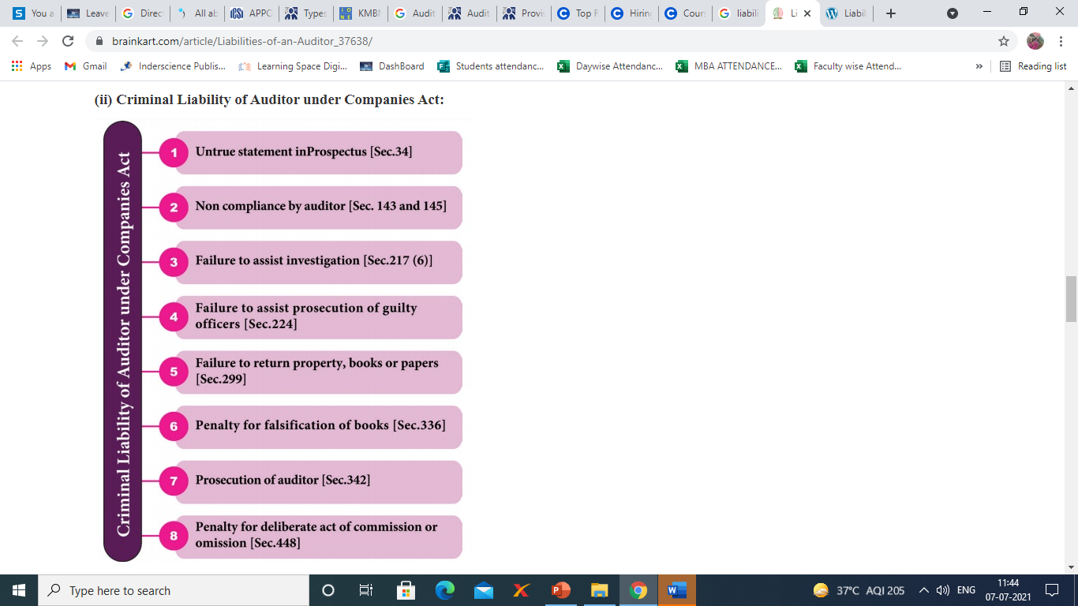
Liabilities of Auditor
1. Liability for Misstatements in the Prospectus [Sec.35]Auditor.docx
2. Criminal Liability of Auditor under Companies Act.

Slide 68
Power of Auditor
Right to access :
Every auditor of a company shall have right to access at all time to book of accounts and vouchers of the company. The Auditor shall be entitled to require from officers of the company such information and explanation as he may consider necessary for performance of his duties
Auditor to sign audit reports :
The auditor of the company shall sign the auditor’s report or sign or certify any other document of the company and financial transactions or matters, which have any adverse effect on the functioning of the company mentioned in the auditor’s report shall be read before the company in general meeting and shall be open to inspection by any member of the company.

Slide 69
Power of Auditor (continue..)
Auditor in general meeting:
It is a prime requirement under section 146, that the company must send all notices and communication to the auditor, relating to any general meeting.
Right to remuneration
The remuneration of the auditor of a company shall be fixed in its general meeting or in such manner as may be determined therein. It must include the expenses, if any, incurred by the auditor in connection with the audit of the company and any facility extended to him but does not include any remuneration paid to him for any other service rendered by him at the request of the company.
Consent of auditor
As per section 26, the company must mention in their prospectus the name, address and consent of the auditors of the company.

Slide 70
Duties of Auditor
Make report
The auditor shall make a report to the members of the company on accounts examined by him on every financial statements.
Audit report of Government Company :
The auditor of the government company will be appointed by the Comptroller and Auditor-General of India and such auditor shall act according to the directions given by them. He must submit a report to them which should include the action taken by him and impact on accounts and financial statement of the company.
Liable to pay damages

Slide 71
Duties of Auditor (continue..)
Branch Audit
Auditing Standards
Fraud Reporting
Winding up

Slide 72
Winding UP
The process of selling all the assets of a business, paying off creditors, distributing any remaining assets to the principals or parent company, and then dissolving the business. Winding up can refer to such a process either for a specific business line of a corporation or to the dissolution of a corporation itself.

Slide 73
Kinds of winding up
Winding up by the Tribunal
Filling winding up petition
Final order an its content
Voluntary winding up

Slide 74
Daily Quiz
Which of the following are not required to issue prospectus?
A. Private company
B. In case of right issue
C. Sweat equity issue
D. All of the above
Who undertakes the management and control of the affairs of the company on behalf of its owners?
A. Company secretary
B. Board of directors
C. Promoters
D. None of the above
Which of the following is a type of meeting of shareholders.
A. Annual general meeting
B. Extra ordinary general meeting
C. Class meeting
D. All of the above

Slide 75
Daily Quiz
The auditor has a right to___.
A. obtain information and explanation
B. obtain information and explanation from the employees and offices
C. obtain information and explanation necessary for auditing
D. both b & c
Which of the following are the modes of winding up?
A. Voluntary winding up
B. Compulsory winding up by tribunal
C. Both a & b
D. None of the above

Slide 76
Weekly Assignment
Explain about prospectus
Explain about meetings
Explain about duties of directors
Explain about winding up
Explain about duties of directors
Discuss the appointment and duties of auditor.
What constitute a prospectus?

Slide 77
Lecture Related to Topic
Directors: https://youtu.be/0PKIzaFAKOk
Auditors: https://youtu.be/f9jl2BKgQX8

Slide 78
Topic Objective/ Topic outcome
Name of Topic | Objective of Topic | Mapping with CO
E-Governance and role of engineers in E-Governance, Need for reformed engineering serving at the Union and State level, Role of I.T. professionals in Judiciary, Problem of Alienation and Secessionism in few states creating hurdles in Industrial development. | Students will be able to learn about Correlate role of engineers with different organizations and governance models | CO5

Slide 79
E-Governance
Electronic governance or e-governance implies government functioning with the application of ICT (Information and Communications Technology). Hence e-Governance is basically a move towards SMART governance implying: simple, moral, accountable, responsive and transparent governance.

Slide 80
Interactions in e-Governance
G2C (Government to Citizens)
G2B (Government to Business)
G2G (Government to Government)
G2E (Government to Employees)

Slide 81
Role of engineers in E-Governance
The role of engineering has suffered many changes over the last few decades, although its concept which is based on trial and error has remained an essential element of the scientific-technological method; where social, environmental and human factors define the most suitable solution to manage a particular issue.
Thus, the engineer's role is continuing reshaped according to the new challenges and necessities implicated by specialized disciplines on the areas of E-governance. The role of engineers in the field of E-governance is focus on identifying the needs of the public and to design the process which is more user friendly, secured and fast..

Slide 82
E-Governance
Some of the guiding principles for reforming E -governance with the
help of technology are:
Form simplification and field reduction — Forms should be made simple and user friendly and only minimum and necessary information should be collected.
Online applications and tracking - Online applications and tracking of their status should be provided.
Online repositories - Use of online repositories e.g., for certificates, educational degrees-, identity documents, etc. should be mandated so that citizens are not required to submit these documents in physical form.

Slide 83
E-Governance(Continue..)
Some of the guiding principles for reforming E -governance with the help of technology are:
Integration of services and platforms — Integration of services and platforms e.g., Aadhaar platform of Unique Identity Authority of India (UIDAI), payment gateway, Mobile Seva platform, sharing of data through open Application Programming Interfaces.
Databases and information in electronic form - The workflow inside government departments and agencies should be automated to enable efficient government processes and also to allow visibility of these processes to citizens .

Slide 84
Need for reformed engineering serving at the Union and State level
To learn more than one discipline: Various streams of engineering are becoming more interdisciplinary. To solve the problems in future will need sufficient understanding of more than one area and the same would be true for mechanical, civil and other engineering areas, as good designs will need integrated understanding of user, society, environment etc.
Need for new skills: As more focus is on self-reliance under the umbrella of "Atmanirbhar", it will invariably mean a greater focus on the manufacturing sector and developing indigenous technologies and solutions.

Slide 85
Need for reformed engineering serving at the Union and State level(Continue..)
India as a land of opportunity: With the development of a vibrant start-up ecosystem in the country, students are more opting for entrepreneurial ambitions so the necessary skills and training should be imparted to the students for the said career
Need to move to a Research Ecosystem: There is a need to have a vibrant corporate research ecosystem to motivate the students for further research work as it is a more services driven industry and customer centric market so more innovations and creativity is the key to the success.

Slide 86
Role of I.T. professionals in Judiciary
“Throughout the world, information and communication technologies are generating a new industrial revolution already as significant and far-reaching as those of the past. It is a revolution, itself the expression of human knowledge. Technological progress now enables us to process, store, retrieve and communicate information in whatever form it may take, unconstrained by distance, time and volume. This revolution adds huge new capacities to human intelligence and constitutes a resource which changes the way we work together and the way we live together."

Slide 87
Role of I.T. professionals in Judiciary(Continue..)
Modernizing the Judiciary
Text Creation, Storage and Retrieval
Improved Access to the Law
Recording of Court Proceedings
Case Management

Slide 88
Role of I.T. professionals in Judiciary(Continue..)
1. Text Creation, Storage and Retrieval
If an electronic version of the court file was maintained it would speed the cost of preparing a record for appeal purposes, thus eliminating one of the bottlenecks to the speedy delivery of justice.
2. Improved Access to the Law
What makes the situation even much more promising is that document production now is digital making it easy to copy and distribute information at very little cost.
IT has the potential to tremendously improve access to the law, improving the productivity of the consumers of the same, and possibly both the quality and quantity of what they produce, thus increasing both the efficiency and efficacy of the their product.

Slide 89
Role of I.T. professionals in Judiciary(Continue..)
3. Recording of Court Proceedings
With the use of IT the pace of proceedings may be speeded up considerably. The quality of the record is enhanced immensely as it is far more accurate. Cases ought to be resolved faster, both at trial, and on appeal.
4. Case Management
Computing has greatly enhanced our capacity to capture study and manipulate data producing reports and other records that one might be interested in. It is possible using programmes that can be developed to track events and cases with a view to availing the decision maker information in a timely manner.

Slide 90
Problem of Alienation and Secessionism in few states creating hurdles in Industrial development
North East India (NEI) today comprises of eight states of India, namely Sikkim and the “seven sister states” of Assam, Arunachal Pradesh (ALP), Nagaland, Manipur, Mizoram, Tripura and Meghalaya. NEI is bounded by Tibet Autonomous Region (TAR), Nepal, Bhutan, Myanmar and Bangladesh. The region is rich in bio-diversity and untapped raw materials. It is connected to mainstream India through the 22 km narrow “Siliguri Corridor”. Thus it has strategic, political and economic significance for India.
NEI has been witnessing insurgency since 1950s and there is no end in sight. Even though some states in the NEI have remained peaceful after ending insurgencies, overall the situation in the region is not conducive to peaceful living and corresponding prosperity. This article covers the genesis of insurgency, the present day situation and makes some recommendations for future.

Slide 91
Problem of Alienation and Secessionism in few states creating hurdles in Industrial development.(Continue..)
North East India (NEI) today comprises of eight states of India, namely Sikkim and the “seven sister states” of Assam, Arunachal Pradesh (ALP), Nagaland, Manipur, Mizoram, Tripura and Meghalaya. NEI is bounded by Tibet Autonomous Region (TAR), Nepal, Bhutan, Myanmar and Bangladesh. The region is rich in bio-diversity and untapped raw materials. It is connected to mainstream India through the 22 km narrow “Siliguri Corridor”. Thus it has strategic, political and economic significance for India.
NEI has been witnessing insurgency since 1950s and there is no end in sight. Even though some states in the NEI have remained peaceful after ending insurgencies, overall the situation in the region is not conducive to peaceful living and corresponding prosperity. This article covers the genesis of insurgency, the present day situation and makes some recommendations for future.

Slide 92
Problem of Alienation and Secessionism in few states creating hurdles in Industrial development.(Continue..)
Reasons for Insurgency in NEI
Multi-Ethnic Region
Underdeveloped Region
Lack of Economic Development.
Sense of Isolation, Deprivation and Exploitation.
Demographic Changes.
Internal Displacement.
External Support.
Impact of Revolutionary Politics.

Slide 93
Daily Quiz
The use of IT to improve the ability of government to address the needs of society is known as ____. (a) E-Business (b) E- Administration (c) E- Governance (d) E- Marketing
Which description is appropriate among the following for ‘ E- Governance’? (a) To engage, enable and empower the citizens (b) To provide fair and unbiased to the citizens (c) To provide technology driven governance (d) To ensure people faith in E –commerce application

Slide 94
Daily Quiz
Poverty and ____ are twin problem found in India? (A) Unemployment (B) Child labour (C) Casteism (D) Crime
Which among the following are reasons for insurgency in NEI? (A) Multi-Ethnic Region
(B) Underdeveloped Region
(C) Lack of Economic Development.
(D) All of the above

Slide 95
Daily Quiz
_____ allows a business application on the computer of one organization to communicate directly with the business application on the computer of another company. (A) EDI (B) Protocols (C) Standards (D) Business application
Following are the advantages of E- Governance.
(A) High transparency
(B) Increased convenience
(C) Reduction to overall cost
(D) All of the above

Slide 96
Weekly assignment
Discuss the role of IT professionals in judiciary.
Discuss the Problem of Alienation and Secessionism in few states creating hurdles in Industrial development.
Write the Need for reformed engineering serving at the Union and State level

Slide 97
Lecture Related to Topic
E-governance: https://youtu.be/LNrLmKtl3QY
Problem of Alienation and Secessionism in few states creating hurdles in Industrial development. https://youtu.be/LQYKOeR87d4

Slide 98

Glossary Questions
1.
Pick the correct answer from given Glossary:
Company | Prospectus | MOA | AOA
1. ____ is a separate legal entity.
2. Powers, rights, remuneration, and duties of directors are discussed clearly in _____.
3. A copy of ____ must accompany each form of application for shares offered by public.
4. ____ describes the rules, regulations and the bye-laws for the internal management of the company

Slide 99
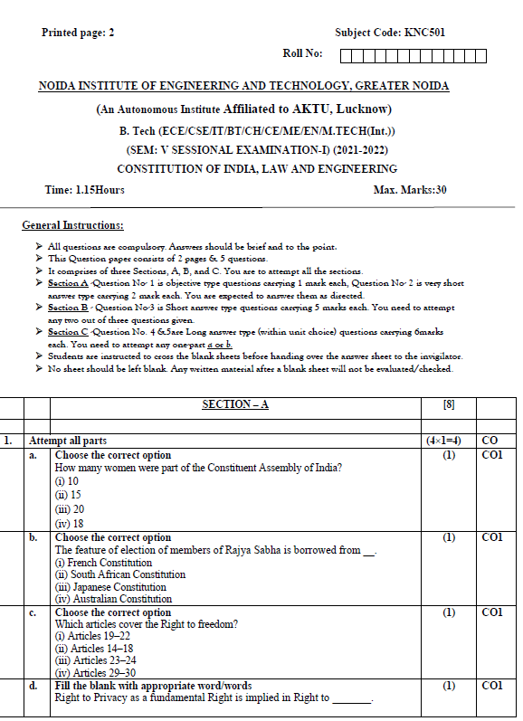
Sessional paper - I

Slide 100
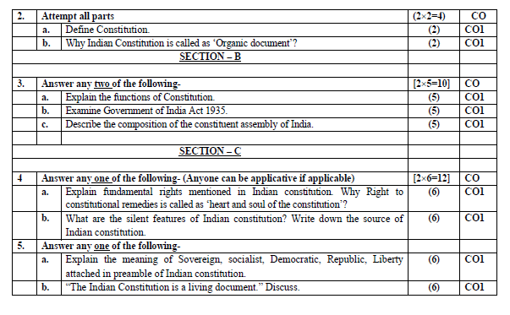
Sessional paper - I

Slide 101
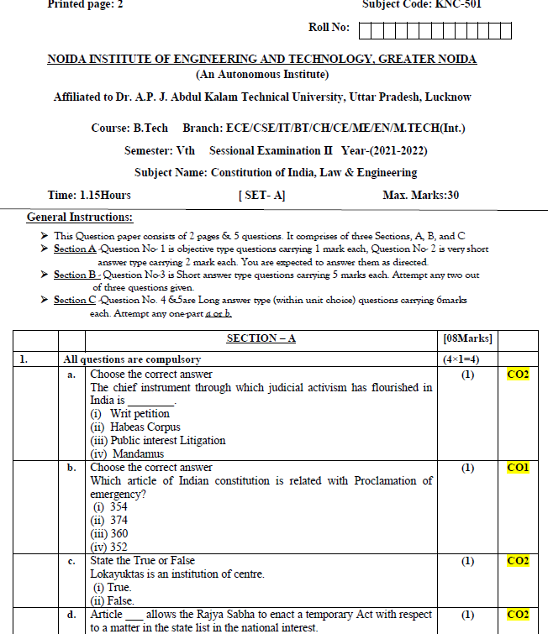
Sessional paper -II

Slide 102
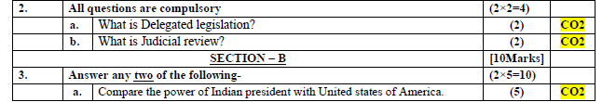
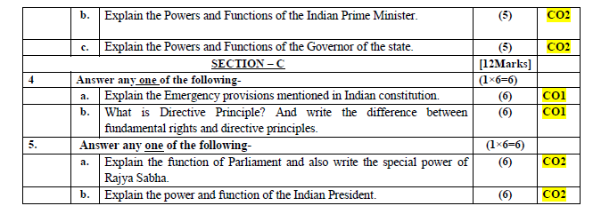
Sessional paper -II

Slide 103
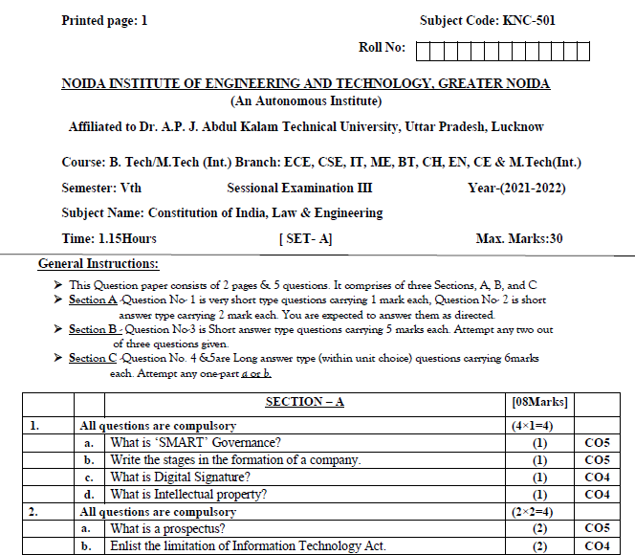
Sessional paper -III

Slide 104
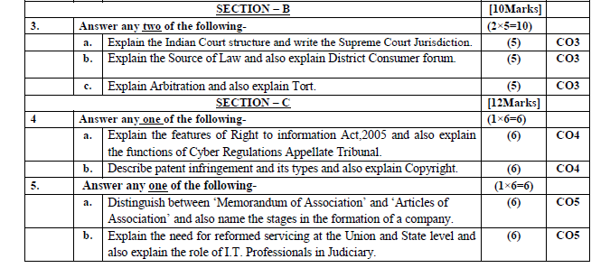
Sessional paper -III

Slide 105
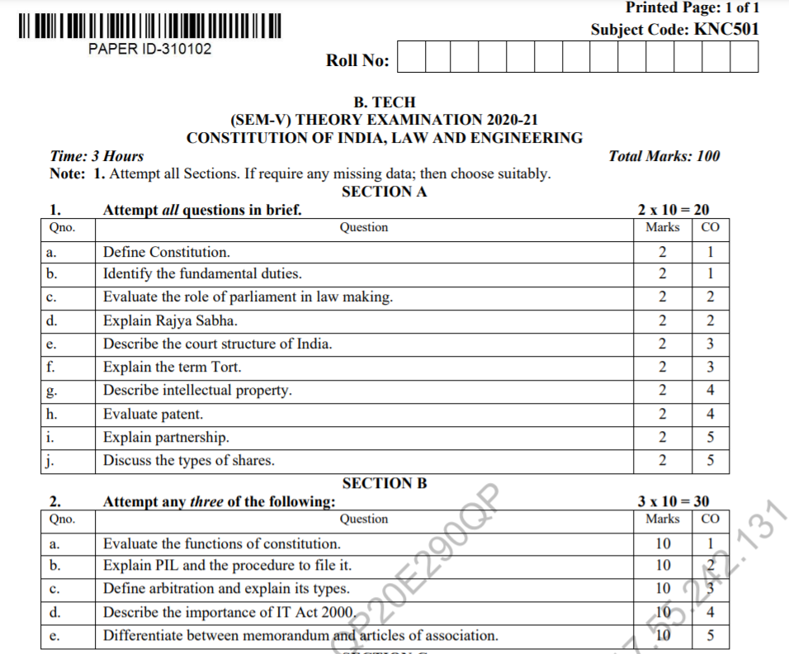
Old Question Papers

Slide 106
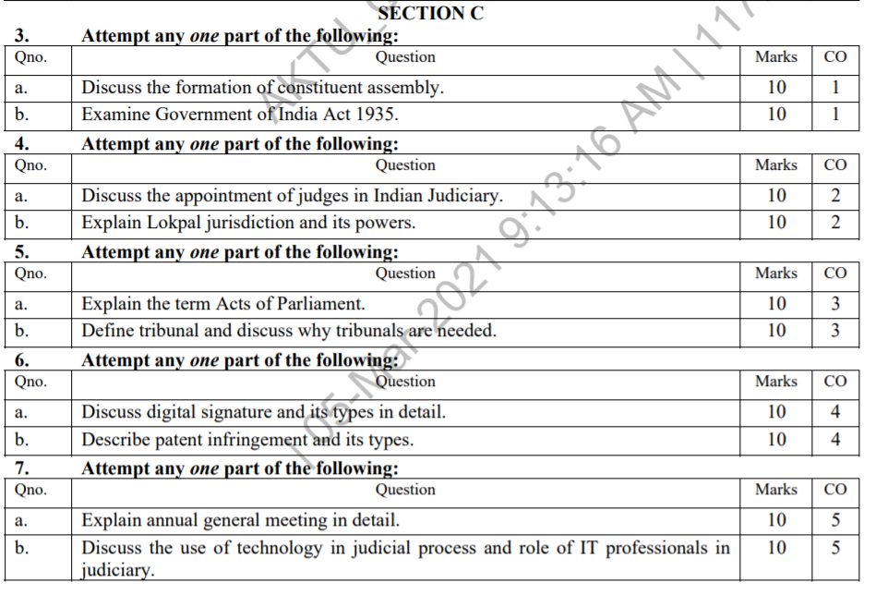
Old Question Papers

Slide 107
Expected questions for University Exams
Define company according to company act.
Discuss Companies Act.
Explain definition, characteristics and kinds of companies.
Explain steps in formation of company.
Define Memorandum of Association.
Define Articles of Association.
Define prospectus in Companies Act.
Discuss about Directors appointment, power, duties and liabilities.
Discuss about meeting and resolutions in the lite of Companies Act
Discuss about types of meetings.
Discuss about Auditors appointment, rights and liabilities, modes of winding up of a company.
12. Discuss the use of IT professionals in judiciary.

Slide 108
Recap
The Companies Act 2013 passed by the Parliament received the assent of the President of India on 29th August 2013. The Act consolidates and amends the law relating to companies. The Companies Act 2013 was notified in the Official Gazette on 30th August 2013. Some of the provisions of the Act have been implemented by a notification published on 12th September, 2013. The provisions of Companies Act 1956 are still in force.
Technological progress now enables us to process, store, retrieve and communicate information in whatever form it may take, unconstrained by distance, time and volume. This revolution adds huge new capacities to human intelligence and constitutes a resource which changes the way we work together and the way we live together."

